Slide 1
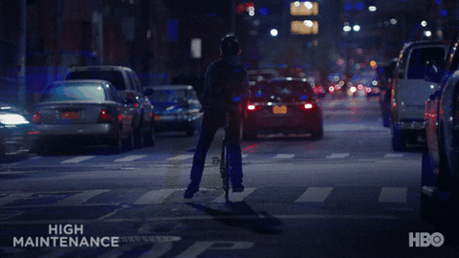
`
Identifying Most Bike-Accident Prone Streets In Vancouver
Notes:
Talk about Vancouver being the most densely populated city in canada
The goal of every major city’s transportation department is to move towards 0 fatalities & injuries from transportation accidents

Slide 2
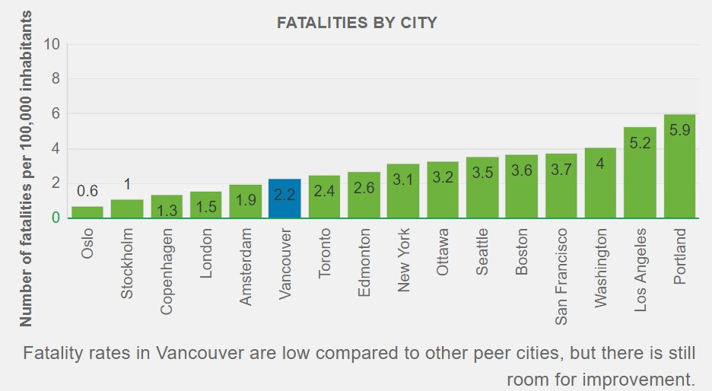
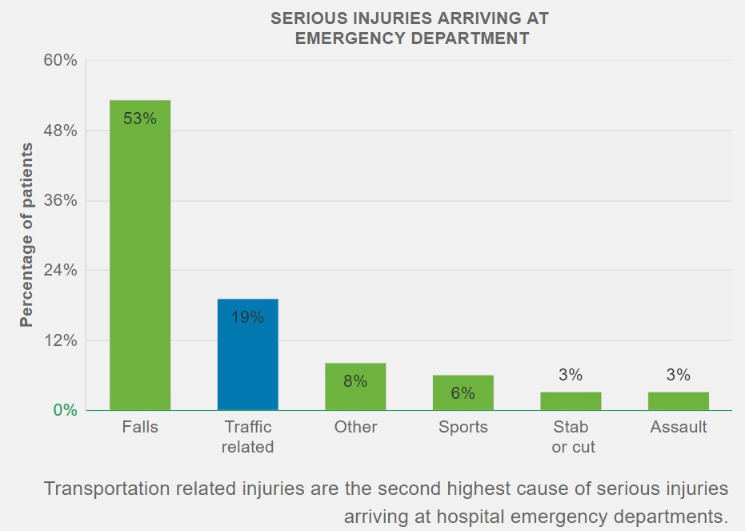
Current Data Trends
Traffic related fatalities in Vancouver have been decreasing over time.
Average Fatality Rate for period 2013-15 is 2.2
Current trend is not that bad as compared to peer cities
But, is fatality rate the right measure?
Canada has a very good healthcare system
Data from Vancouver General Hospital (VGH) shows that traffic-related Injuries are the second highest
Notes:
Talk about fatality rate, point out that correct measure is to not look at fatalities but injuries or crashes
2 Major sources to analyze accident data, ICBC (Insurance Corporation of British Columbia) & Hospitals, police department, government websites

Slide 3
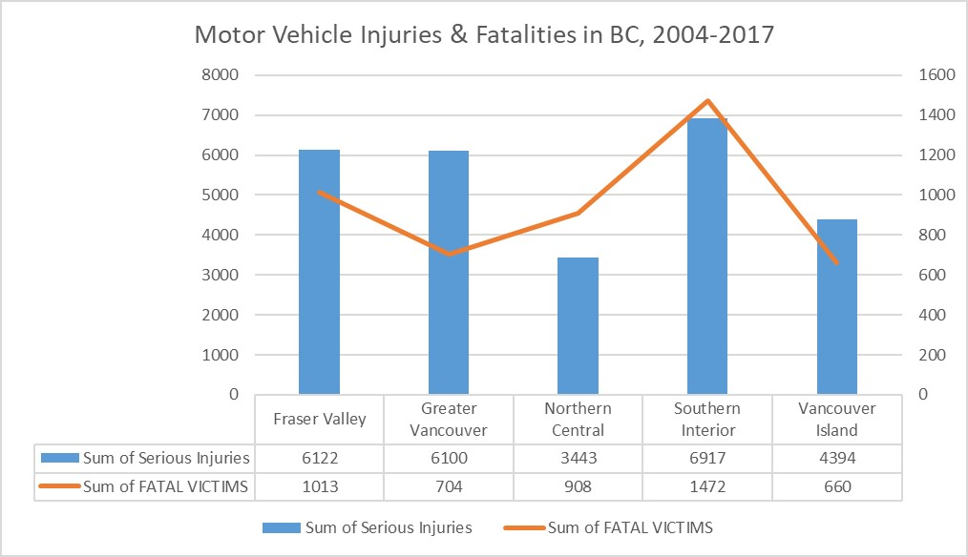
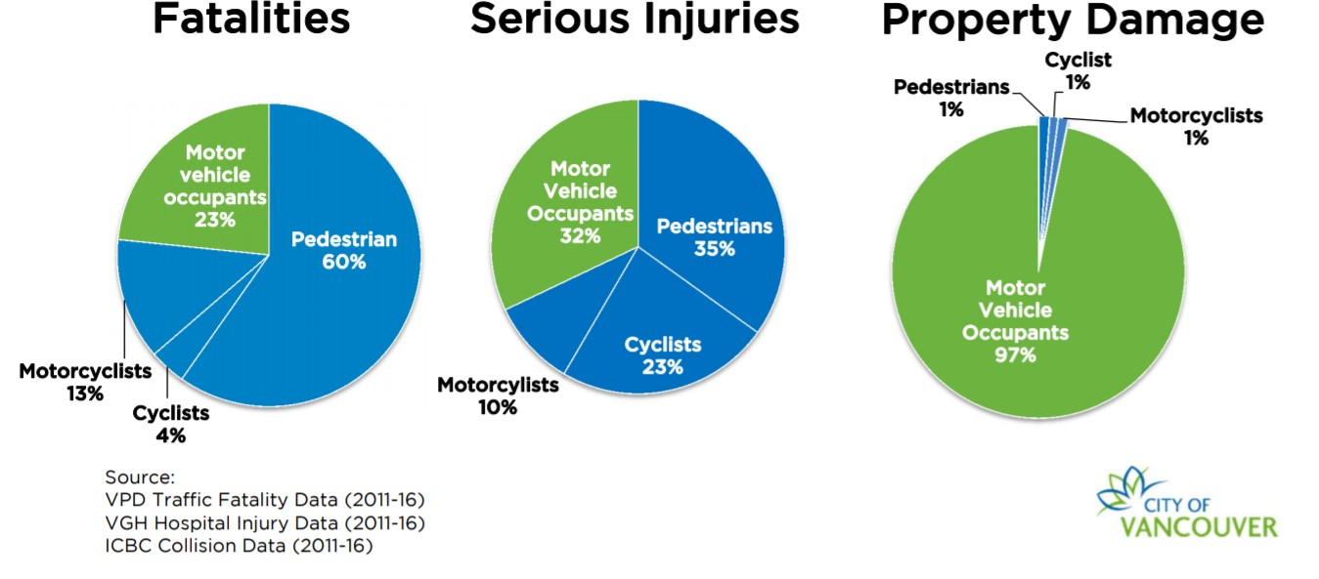
Current Data Trends
Vulnerable Road Users constitute more than 50% of Fatalities & Serious Injuries
Global concern for pedestrian protection
Pedestrian safety is a comprehensive process requiring efforts in Engineering, Education & Enforcement involving both driver & pedestrians
Being a bike friendly city, we can do much better
Greater Vancouver has lower fatalities but higher Injuries

Slide 4
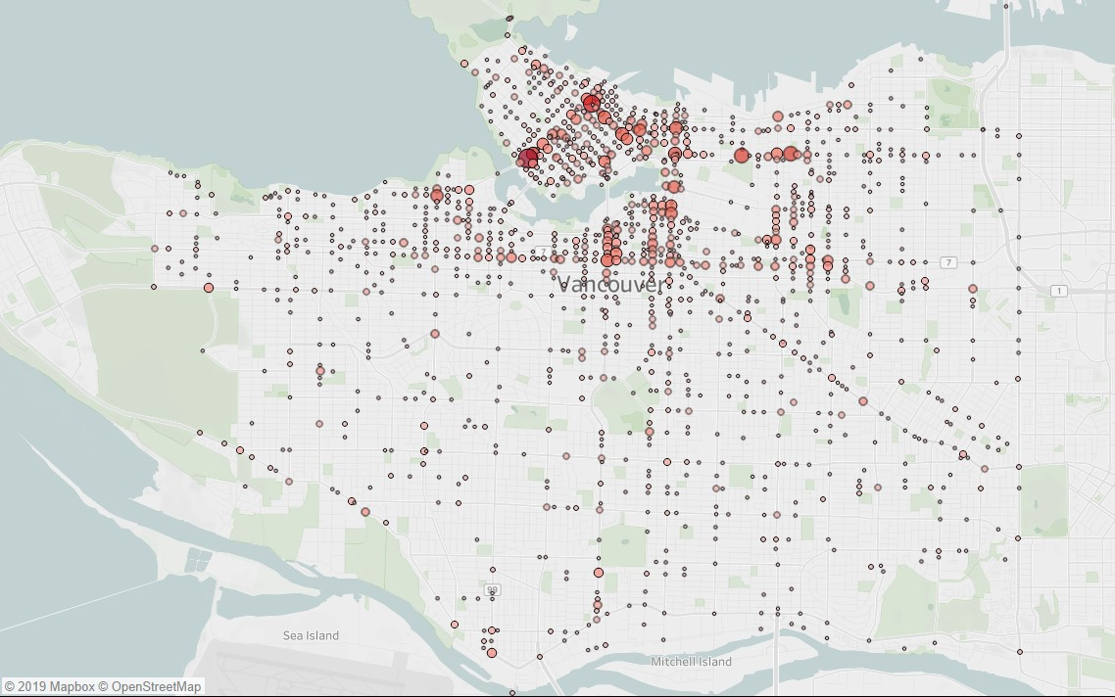
Bike Crashes in Vancouver
Vancouver was ranked 37th best cycling city out of the 90 cities
And, 15th best for most bike-related accidents
Public data by ICBC for bike crashes (2013-17) in the city highlights most dangerous intersections

Slide 5
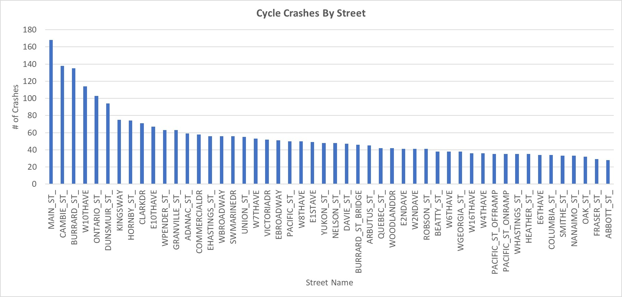
Top 50 Streets for Most Bike-Crashes
~10%(50 Streets) out of 506 streets accounted for 50% of the crashes
~29%(147 Streets) out of 506 streets accounted for 80% of the crashes
Key Areas of Improvement- a well-connected network of cycling lanes, a good education system for cycling
Rewards- Better Safety, Better Traffic Condition, Better Ranking

